Slide 1
Office 365 Development

Slide 2
Office 365 APIs
Office 365 Development Overview

Slide 3
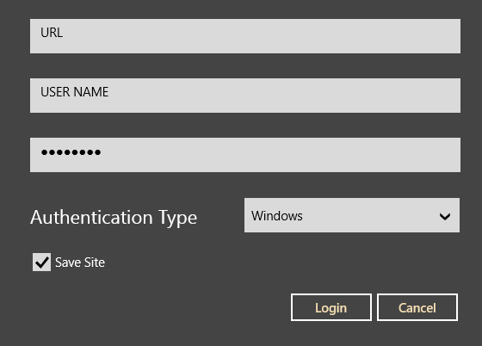
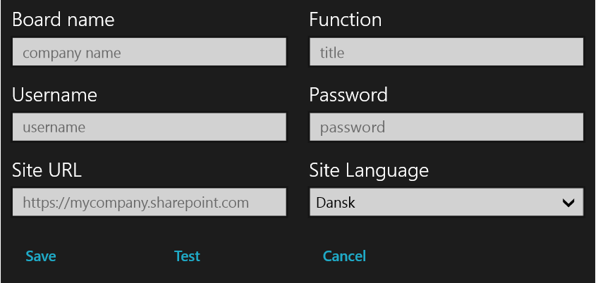
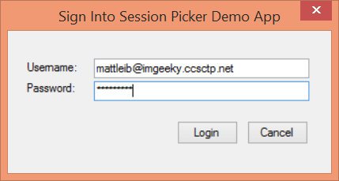
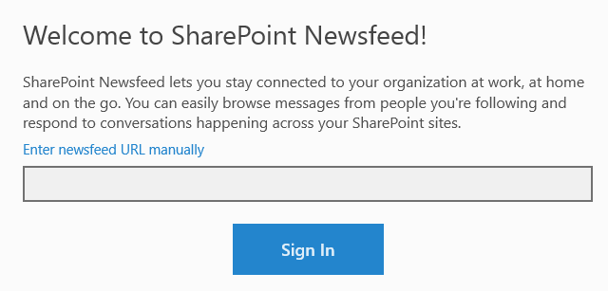
Office 365 device apps

Slide 4
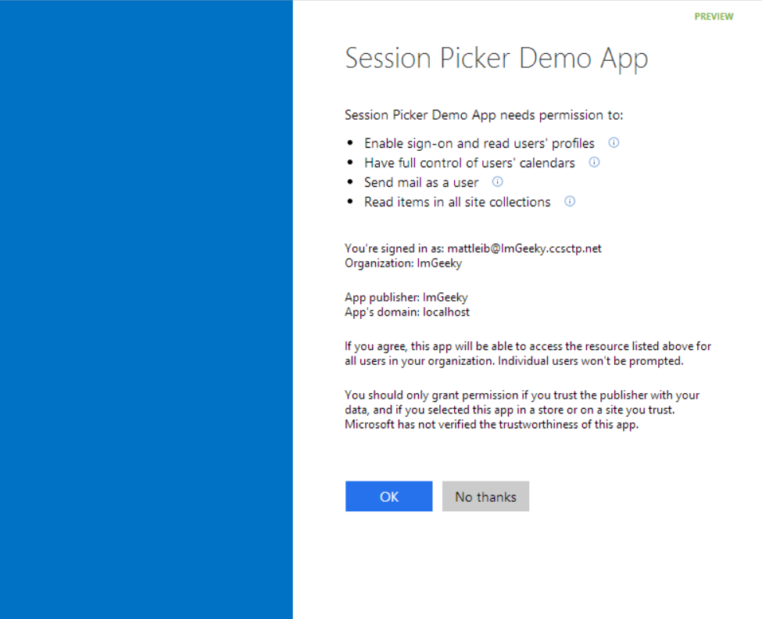
Common Consent

Slide 5
The SharePoint client APIs
Sites, Lists and Libs
Workflow
Search
Taxonomy
BCS
…
_api
Execute query
REST/ OData
JavaScript library
Silverlight library
.NET CLR library
Custom client code

Slide 6
Office 365 APIs
Active Directory
Exchange & Outlook.com
SharePoint
OneDrive
Sites
OneDrive
Users
Mail
Calendar
Client API
OneDrive for Business
Sites, Lists and Libs
Taxonomy
Groups
Contacts
Workflow
BCS
Search
…

Slide 7
Continuous innovation
LAST YEAR
THIS YEAR
THE FUTURE
Apps for SharePoint
Apps for Office
VS tooling
Store and lifecycle
Contextual apps
Compose time apps
Robust Office 365 APIs
Tools and platform
Android SDK
Adding new endpoints
More APIs (Tasks, Office Graph)
iOS SDK
Embracing Open
Integrating platform + Tools
Empowering users
Notes:
Specific talking points on “show some leg:”
Endpoints
Building Apps for Office on the MAC
Filling in Apps in Office Online, Word
Connecting Entities
Adding Entities for feeds and tasks.
Embracing more of O365
Working on tools to help developers navigate between entities, like you see in Pulse (We’re showing this, right?)
Embracing Open
Double-down on open standards, interop, protocols and programming frameworks
Making more open source projects
Contributing to more open source projects
Integrating Platform
Easier to manage apps across Azure and O365
More support from VS for apps across not just SharePoint, but all of O365
Empowering Users
Make it easier for users to build solutions without code
Connect those solutions to enhancement from pro-devs

Slide 8
demo
Asp.net MVC project
Notes:
Research Project

Slide 9
Tools
Office 365 Development Overview

Slide 10
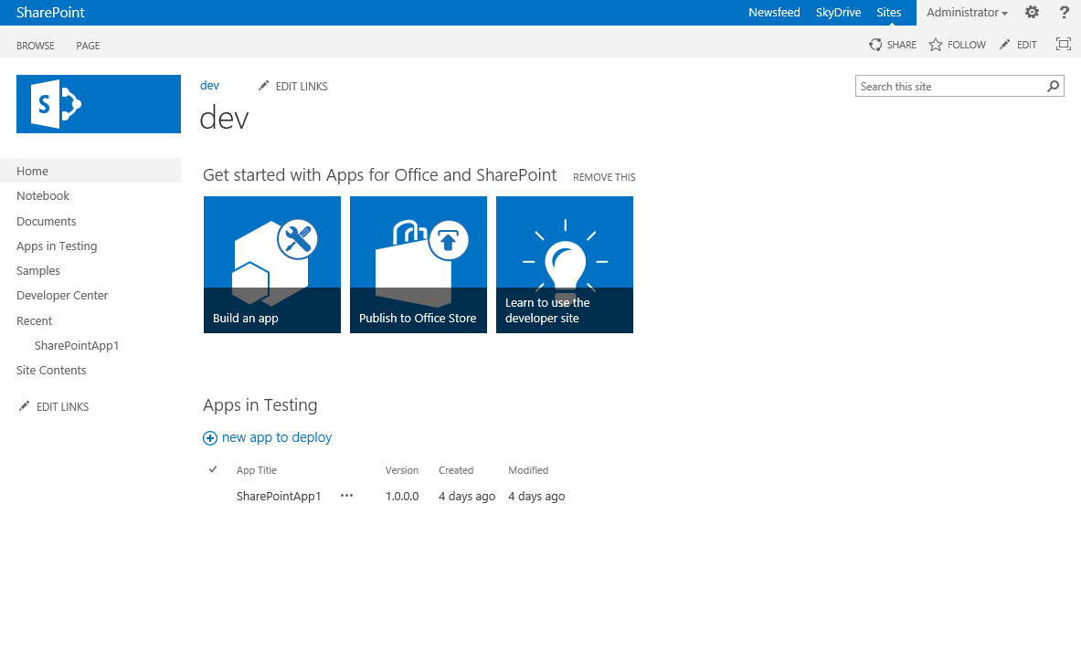
Developer template and usage
Enables remote development against the SharePoint farm
Also with on-premises deployments

Slide 11
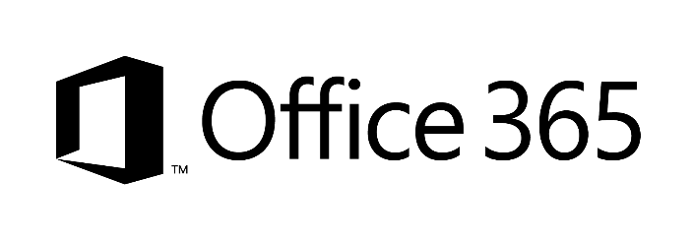









Developer sites and remote development
2
1
3
1
4
1
Notes:
Clients using remote development tools
Preferred option is to use Office365 – you can share even the same instance cross your App developers
You can also host your SharePoint Windows Azure IaaS server – so that development occures agains that instance
Just as for IaaS, you can do development againts shared on-premises instance – most likely you’d dedicate site collection per developer for testing usage
TFS – could be on-prem, hosted in IaaS platform or used as service from cloud

Slide 12
Resources
Office 365 Development Overview

Slide 13
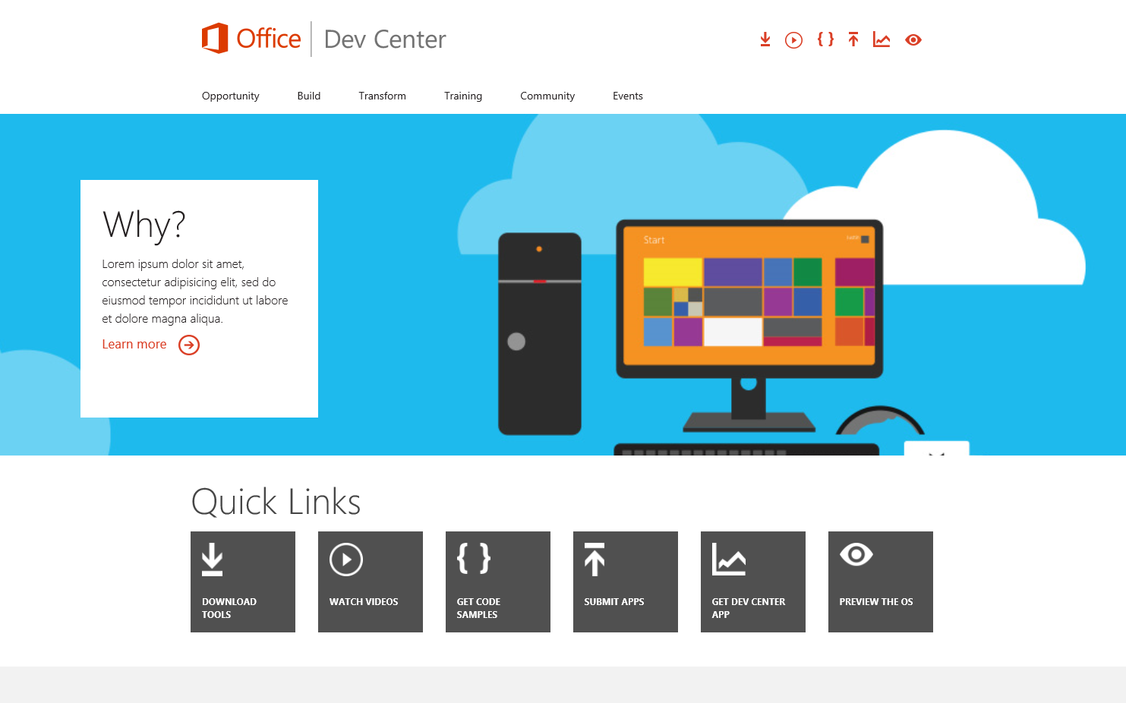
Office 365 Developer Center
dev.Office.com
Opportunity
Build
Transform
Code Samples
Patterns & Practices
API Reference
Community

Slide 14
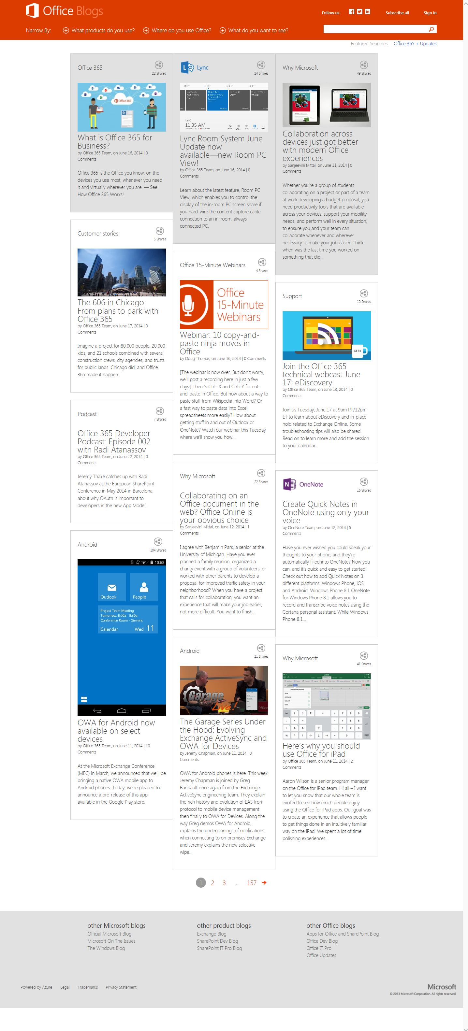
Office Blogs
Office 365 news
Dev announcements
Events
Garage Series videos
Weekly podcast

Slide 15
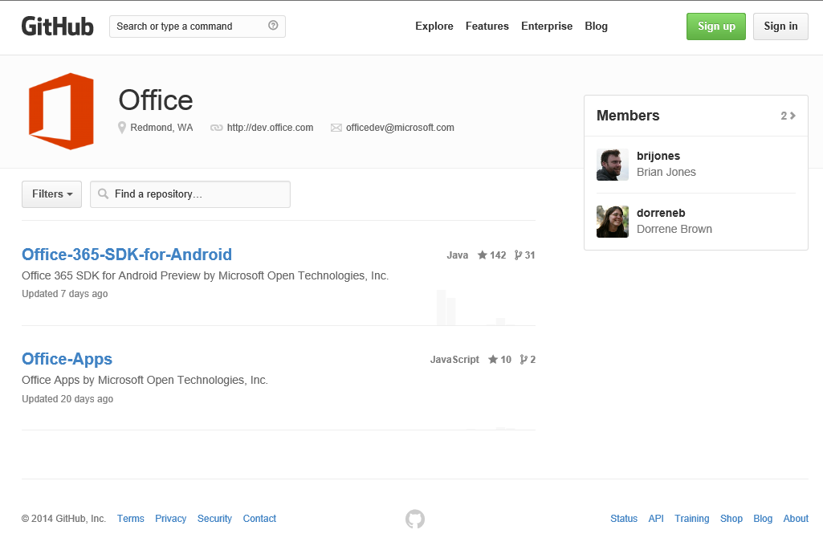
GitHub
Github.com/OfficeDev
SDKs
Android SDK
Code Samples
Wikipedia App for Word
Campaign Manager for Android
Expense Manager for Windows 8
Research Manager inc. AngularJS
Building Snippets for Word
Contribute
We want your enhancements and your samples!

Slide 16
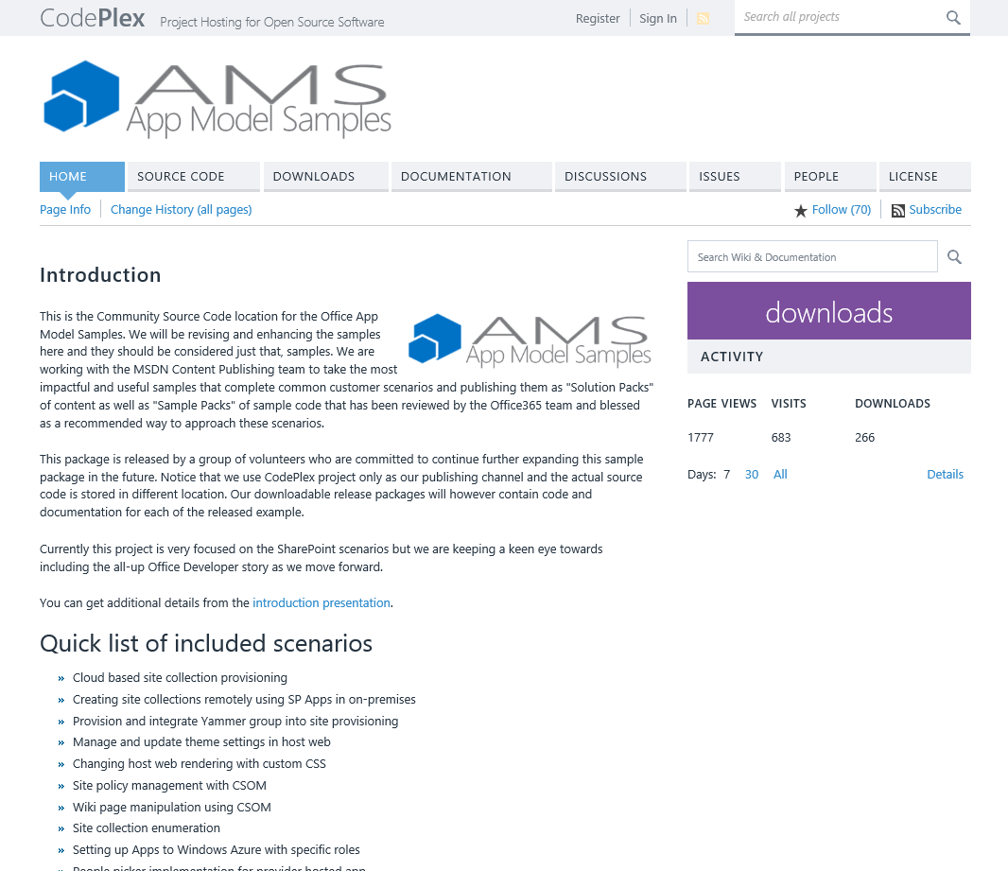
Patterns & Practices
Providing App Model Patterns for common Full Trust Code scenarios
30+ Visual Studio Projects
Common scenarios
Branding
Site Provisioning
Remote Event Receivers
Large file support
Taxonomy driven navigation
And much more…
Contribute
Open source coming soon!

